Slide 1
MANAGING THE DIGITAL FIRM
Laudon & Laudon
PowerPoint by Daniel Obuobi

Slide 2
Information Systems
Why Information Systems?
Information technology and systems have revolutionized firms and industries, and have become the largest component of capital investment in the U.S. and many industrialized societies.
Investment in information technology accounts for more than one-third of all capital invested in the United States. [Figure 1-1]

Slide 3
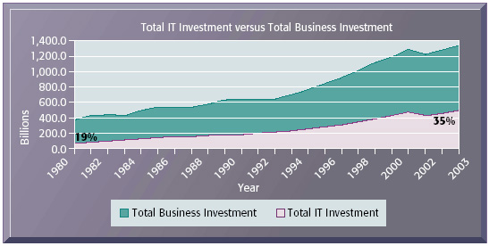
Information technology capital investment
FIGURE 1-1 Information technology capital investment
Information technology capital investment, defined as hardware, software, and telecommunications equipment, expanded from 19 percent of all business investment to 35 percent during the period from 1980 to 2003.
Source: Based on data in U.S. Department of Commerce, Bureau of Economic Analysis, National Income and Product Accounts, Tables 5.2 and 5.8, 2004.

Slide 4
IS foundation for business
Information systems are the foundation of doing business for e-commerce and many industries such as finance, insurance, real estate, travel, medicine, and education. The ability of a firm to use IT is becoming intertwined with the firm’s ability to implement corporate strategy.
IT is one of the more important tools, along with related innovations in organization and management, for achieving strong gains in productivity. [Figure 1-2]

Slide 5
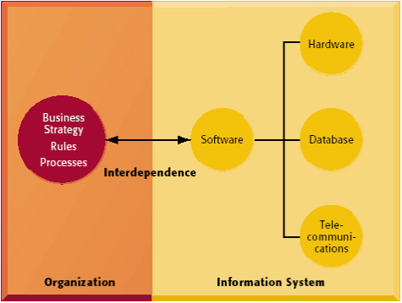
The interdependence between organizations and information systems
FIGURE 1-2 The interdependence between organizations and information systems
In contemporary systems, there is a growing interdependence between a firm’s information systems and its business capabilities.
Changes in strategy, rules, and business processes increasingly require changes in hardware, software, databases, and telecommunications.
Often, what the organization would like to do depends on what its systems will permit it to do.

Slide 6
IT Investment
IT investments are very often essential for realizing new business opportunities and competitive strategies.
There is considerable variation in firms’ ability to use IT effectively.
IT strategies that are successful for one firm may not be successful for another.
Successful IT investment must be accompanied by significant changes in business operations and processes as well as changes in management culture and behavior.

Slide 7
Factors illustrating growing impact of IT in business firms today
Five factors illustrate the growing impact of IT in business firms today and over the next ten years.
The Internet and Technology Convergence: The merging of telephone networks into the Internet and growth of Internet-connected devices illustrate the breakdown of traditional boundaries and growth of new markets and business relationships. Firm’s relationships with business partners and clients are becoming digital relationships. Digital networks have enabled electronic business (e-business), electronic commerce (e-commerce), and e-government.
Transformation of the Business Enterprise: The Internet and new markets are changing traditional revenue structures and business models. Firms are no longer limited by traditional organizational boundaries or physical locations. Information technology has provided the opportunity for organizations to become flattened (less hierarchical) and decentralized with flexible arrangements of generalists who rely on real time information to deliver mass-customized products and services uniquely suited to specific markets or customers.
Globalization: Information systems provide the communication and analytic power that firms need to conduct trade, manage businesses on a global scale, and become competitive in international markets.
Rise of the Information Economy: The U.S. and other major industrial powers are transforming from industrial economies to knowledge- and information-based service economies, while manufacturing is moving to lower-wage countries. Knowledge and information work account for 60 percent of the US GNP and nearly 55 percent of the labor force. [Figure 1-3]
Emergence of the Digital Firm: A digital firm is one where nearly all significant relationships with customers, suppliers, and employees, as well as key corporate assets, are digitally enabled and mediated.

Slide 8
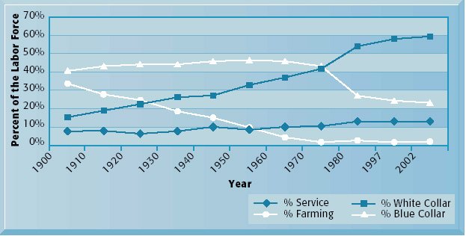
The growth of the information economy
FIGURE 1-3 The growth of the information economy
Since the beginning of the twentieth century, the United States has experienced a steady decline in the number of farm workers and blue-collar workers who are employed in factories. At the same time, the country is experiencing a rise in the number of white-collar workers who produce economic value using knowledge and information.
Source: U.S. Department of Commerce, Bureau of the Census, Statistical Abstract of the United States, 2003, Table 615; and Historical Statistics of the United States, Colonial Times to 1970, Vol. 1, Series D, pp. 182–232..

Slide 9
Emergence of digital firm
Emergence of the Digital Firm: A digital firm is one where nearly all significant relationships with customers, suppliers, and employees, as well as key corporate assets, are digitally enabled and mediated.
Core business processes are accomplished thorough digital networks spanning the entire enterprise or linking multiple organizations.
Business processes are the unique ways in which organizations coordinate and organize work activities, information, and knowledge to produce a product or service. Filling an order is an example of a business process.
Digital firms are able to respond more rapidly, operate with more flexibility, and achieve greater levels of efficiency, profitability, and competitiveness. [Figure 1-4]

Slide 10
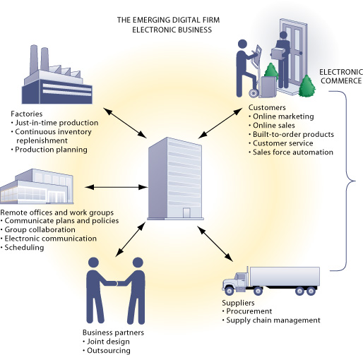
the Digital Firm
FIGURE 1-4 Electronic business and electronic commerce in the emerging digital firm
Companies can use Internet technology for e-commerce transactions with customers and suppliers for managing internal business processes, and for coordinating with suppliers and other business partners.
E-business includes e-commerce as well the management and coordination of the enterprise.

Slide 11
Perspectives on Information Systems – technology perspective
IS can be best understood from both technology and business perspective.
Definition: An information system is a set of interrelated components that collect or retrieve, process, store, and distribute information to support decision-making and control in an organization. Information systems can also be used to analyze problems, visualize complex subjects, and create new products.
Information is data, or raw facts, shaped into useful form for humans. [Figure 1-5]

Slide 12
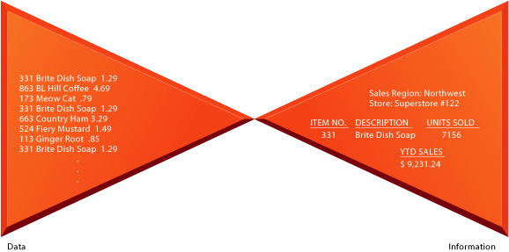
Data and information

Slide 13
Example
Raw data from a supermarket checkout counter can be processed and organized to produce meaningful information such as the total unit sales of dish detergent or the total sales revenue from dish detergent for a specific store or sales territory.

Slide 14
Informal and Formal Information Systems
Informal Information Systems rely on unstated rules of behavior. There is no agreement on what is information and how it is stored and processed. Such systems are essential for the life of an organisation.Eg office gossip network
Formal Information Systems are structured. They operate in conformity with predefined rules that are relatively fixed and not easily changed. They are either manual (pencil and paper) or computer based.

Slide 15
CBIS
Computer-based information systems (CBIS) are structured information systems that rely on computer hardware and software technology.
Information systems are employed to support decision making and control in an organization.
Input, processing, and output are the three activities in an information system that produce the information an organization needs.
Feedback is output returned to the various members of the organization to refine or correct input. [Figure 1-6]

Slide 16
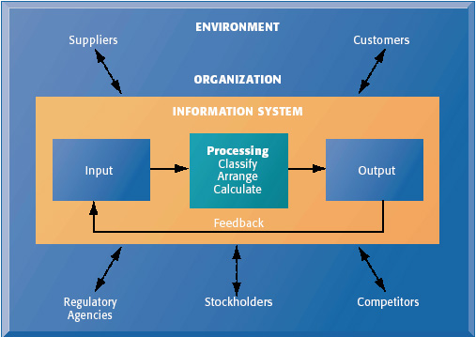
Functions of an information system
Figure 1-6 Functions of an Information Systems
An information system contains information about an organization and its surrounding environment.
Three basic activities—input, processing, and output—produce the information organizations need.
Feedback is output returned to appropriate people or activities in the organization to evaluate and refine the input.
Environmental factors such as customers, suppliers, competitors, stockholders, and regulatory agencies interact with the organization and its information systems.

Slide 17
Functions of an information system
An information system contains information about an organization and its surrounding environment.
Three basic activities—input, processing, and output—produce the information organizations need.
Feedback is output returned to appropriate people or activities in the organization to evaluate and refine the input.
Environmental factors such as customers, suppliers, competitors, stockholders, and regulatory agencies interact with the organization and its information systems.

Slide 18
Business Perspective of information systems
From a business perspective, an information system may be important for increased productivity or increased revenue, for coping with governmental regulations or other environmental demands, or simply for remaining competitive within the industry.
Information systems can also lead to better management decisions, more efficient business processes, and higher firm profitability.
Every business has an information value chain in which raw information is acquired and systematically transformed through various stages that add value to that information. [Figure 1-7]

Slide 19
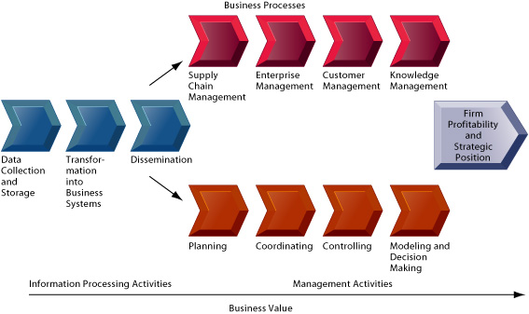
The business information value chain
FIGURE 1-7 The business information value chain
From a business perspective, information systems are part of a series of value-adding activities for acquiring, transforming, and distributing information that managers can use to improve decision making, enhance organizational performance, and, ultimately, increase firm profitability.

Slide 20
IS as Organization & management solution
An information system also represents an organizational and management solution, based on information technology, to a challenge posed by the environment.
Information systems literacy, the understanding of information systems, includes the understanding of the broader organization, management, and information technology dimension of systems and their power to provide solutions. [Figure 1-8]

Slide 21
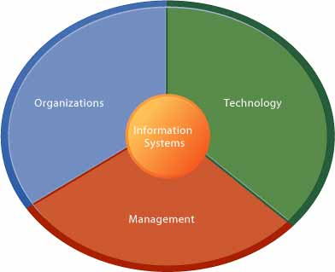
Information systems are more than computers
FIGURE 1-8 Information systems are more than computers
Using information systems effectively requires an understanding of the organization, management, and information technology shaping the systems.
An information system creates value for the firm as an organizational and management solution to challenges posed by the environment.

Slide 22
Dimensions of Information Systems – Organisation component
The key elements of an organization are its people, structure, operating system, politics and culture.
An organization coordinates work through a structured hierarchy and formal, standard operating procedures.
Managerial, professional, and technical employees form the upper levels of the organization's hierarchy while lower levels consist of operational personnel.

Slide 23
Organisation Component of IS
Different kinds of skills and people required in organisation
  Knowledge workers such as engineers and scientists design products and create and distribute new knowledge for the organization.
  Data workers such as secretaries process the organization's paperwork.
  Production or service workers produce the products or services.

Slide 24
Management Component of IS
Different levels of management have different information needs.
Senior managers need information for long-range strategic decisions.
Middle managers need information for carrying out the plans of senior management.
Operational managers need information to monitor the firm's daily activities.

Slide 25
Technology component of IS
Computer-based information systems use computer hardware, computer software, storage technology, and communications technology.
These technologies constitute the firm’s information technology (IT) infrastructure.

Slide 26
IT investments
Information technology investments cannot make organizations and managers more effective unless they are accompanied by complementary assets:
  supportive values, structures, and behavior in the organization and management.
Investments in organizations and management that allow a firm to realize value from technology investments are called organizational and management capital. [Figure 1-9]

Slide 27
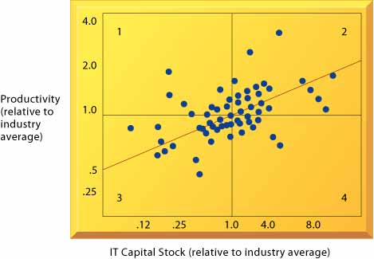
technology investments
FIGURE 1-9 Variation in returns on information technology investment
Although, on average, investments in information technology produce returns far above those returned by other investments, there is considerable variation across firms.
Source: Based on Brynjolfsson and Hitt (2000).

Slide 28
CONTEMPORARY APPROACHES TO INFORMATION SYSTEMS
Information systems are sociotechnical systems.
Though they are composed of machines, devices, and "hard" physical technology, they require substantial social, organizational, and intellectual investments to make them work properly.
Since problems with information systems -- and their solutions -- are rarely all technical or behavioral, a multidisciplinary approach is needed.

Slide 29
Technical Approach & Behavioural Approach
The technical approach emphasizes mathematically based, normative models to study information systems, as well as the physical technology and formal capabilities of these systems.
The behavioral approach, a growing part of the information systems field, does not ignore technology, but tends to focus on non-technical solutions concentrating instead on changes in attitudes, management and organizational policy, and behavior. [Figure 1-10]

Slide 30
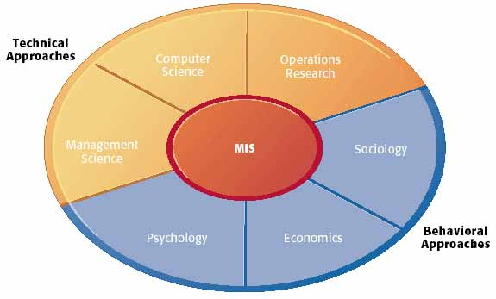
Contemporary approaches to information systems
FIGURE 1-10 Contemporary approaches to information systems
The study of information systems deals with issues and insights contributed from technical and behavioral disciplines.

Slide 31
Technology must be changed and designed, sometimes even “de-optimized,” to fit organizational and individual needs.
Organizations and individuals must also be changed through training, learning, and planned organizational change to allow technology to operate and prosper. [Figure 1-11]

Slide 32
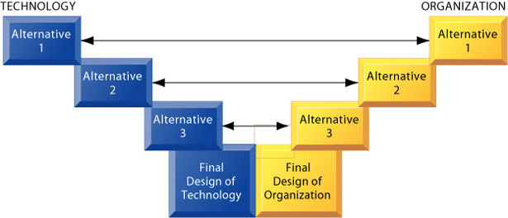
FIGURE 1-11 A socio-technical perspective on information systems
In a socio-technical perspective, the performance of a system is optimized when both the technology and the organization mutually adjust to one another until a satisfactory fit is obtained.

Slide 33
Learning to Use Information Systems: New Opportunities with Technology
Building, operating, and maintaining successful information systems are complex and challenging activities.
Today's managers must consider five key questions:
  The Information Systems Investment Challenge
  The Strategic Business Challenge
  The Globalization Challenge
  The Responsibility and Control Challenge

Slide 34
The Information Systems Investment Challenge
How can organizations obtain business value and realize a return from their information systems?

Slide 35
The Strategic Business Challenge
What complementary assets are needed to use information technology effectively?
Firms must be able to appreciate the complementary organizational and managerial assets required to make their technology assets work.

Slide 36
The Globalization Challenge
How can firms understand the business and system requirements of a global economic environment?
This challenge requires the development of integrated multinational information systems. Accounting and reporting structures must be created to allow organizations to function effectively in a changing world economy.

Slide 37
The Information Architecture and Infrastructure Challenge
How can organizations develop an information architecture and information technology infrastructure that supports their business goals?
Information architecture is the particular form that information technology takes in a specific organization to achieve selected goals and functions.
It is a design for the organization's business application systems serving each functional specialty and level of the organization.
The firm's information technology (IT) infrastructure provides the technology platform for this architecture and includes the organization's computer hardware, software, storage, and communications technology resources.

Slide 38
Ethics and Security: Responsibilty & control challenge
The Responsibility and Control Challenge: How can organizations design systems that people can control and understand?
How can organizations ensure that their information systems are used in an ethically and socially responsible manner?
The potential for massive fraud, error, abuse, and destruction is enormous.
Systems must be designed so that they function as intended and so that humans can control the process.
When building and using information systems, health, safety, job security, and social well-being should be considered as carefully as meeting an organization's business goals.

Slide 39
INFORMATION SYSTEMS IN THE ENTERPRISE
Laudon & Laudon
PowerPoint by Daniel Obuobi

Slide 40
Major Types of Systems in Organizations
Because there are different interests, specialist and levels in an organization , there are different kinds of systems.
No single system can provide all the information an organization needs or serve all of its interests, unique systems are used to handle the differing operational, management, and strategic-level needs. [Figure 2-1]

Slide 41
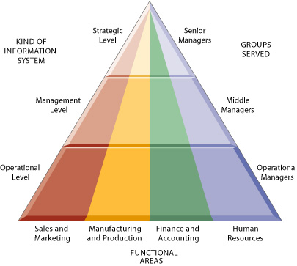
Types of information systems
FIGURE 2-1 Types of information systems
Organizations can be divided into strategic, management, and operational levels and into four major functional areas: sales and marketing, manufacturing and production, finance and accounting, and human resources.
Information systems serve each of these levels and functions.

Slide 42
Different kinds of Systems
Operational-level systems support operational managers’ needs for current, accurate, and easily accessible information primarily used to keep track of the elementary activities and transactions of the organization.
Management-level systems serve the monitoring, controlling, decision-making, and administrative activities of middle managers.
Strategic-level systems help senior managers with long-range planning needed to meet changes in the external and internal business environment.

Slide 43
FUNCTIONAL LEVELS
There are also different information needs for the various business functions: sales and marketing, manufacturing, finance, accounting, and human resources.
A large organization typically has operational, management, knowledge, and strategic level systems for each of these functional areas.

Slide 44
Four specific types of systems
Four major types of systems serve the various organizational levels: executive support systems (ESS); management information systems (MIS); decision-support systems (DSS); and transaction processing systems (TPS).
However, each of the different kinds of systems may have components that are useful to individuals or groups at other levels of the organization. [Figure 2-2]

Slide 45
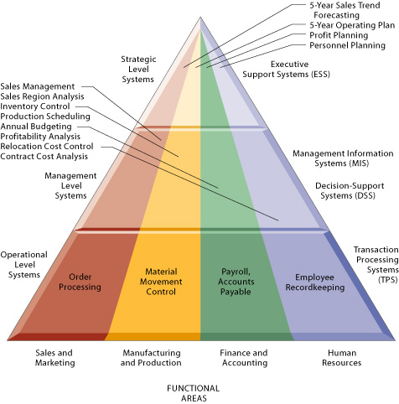
THE FOUR SPECIFIC TYPES OF INFORMATION SYSTEMS
FIGURE 2-2 The four major types of information systems
This figure provides examples of TPS, DSS, MIS, and ESS, showing the level of the organization and business function that each supports.

Slide 46
TPS
TPS are basic business systems that serve the operational level of the organization by recording the daily transactions required to conduct business, such as payroll and sales receipts. [Figure 2-3, Figure 2-4]

Slide 47
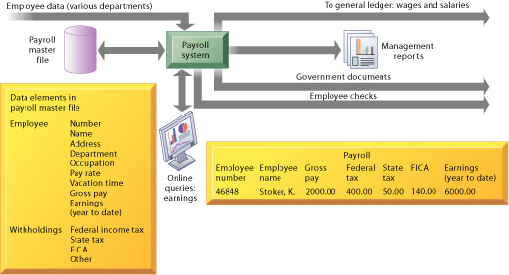
PAYROLL TPS
FIGURE 2-3 A symbolic representation for a payroll TPS
A payroll system is a typical accounting TPS that processes transactions such as employee time cards and changes in employee salaries and deductions. It keeps track of money paid to employees, withholding tax, and paychecks.

Slide 48
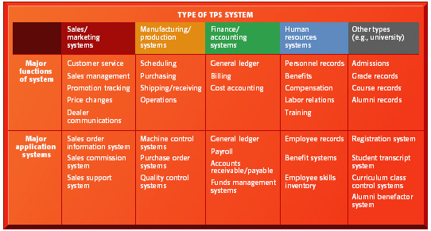
TYPICAL TPS
FIGURE 2-4 Typical applications of TPS
There are five functional categories of TPS: sales/marketing, manufacturing/production, finance/accounting, human resources, and other types of systems specific to a particular industry. Within each of these major functions are subfunctions. For each of these subfunctions (e.g., sales management) there is a major application system.

Slide 49
MIS
MIS serve middle managers' interests by providing current and historical performance information to aid in planning, controlling, and decision-making at the management level.
MIS typically compress TPS data to present regular reports on the company’s basic operations. [Figure 2-5, Figure 2-6]

Slide 50
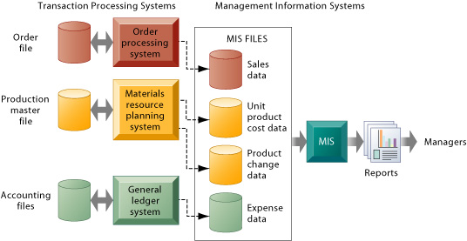
HOW DATA IS OBTAINED FROM TPS
FIGURE 2-5 How management information systems obtain their data from the organization’s TPS
In the system illustrated by this diagram, three TPS supply summarized transaction data to the MIS reporting system at the end of the time period.
Managers gain access to the organizational data through the MIS, which provides them with the appropriate reports.

Slide 51
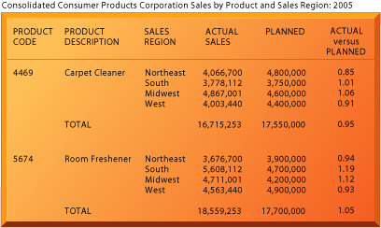
SIMPLE MIS REPORT
FIGURE 2-6 A sample MIS report
This report showing summarized annual sales data was produced by the MIS in Figure 2-5.

Slide 52
DSS
DSS, also called business intelligence systems, help managers with decisions that are unique, rapidly changing, and not easily specified in advance.
DSS are more analytical than MIS, using a variety of models to analyze internal and external data or condense large amounts of data for analysis. [Figure 2-7]

Slide 53
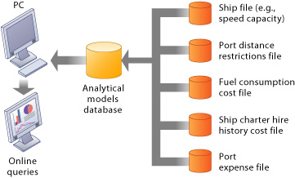
Example of DSS
FIGURE 2-7 Voyage-estimating decision-support system.
This DSS operates on a powerful PC.
It is used daily by managers who must develop bids on shipping contracts.

Slide 54
ESS
ESS provide a generalized computing and communications environment for senior managers at the strategic level of the organization.
ESS are designed to incorporate data about external event and summarized, critical internal data and information to support upper management decision making. [Figure 2-8]

Slide 55
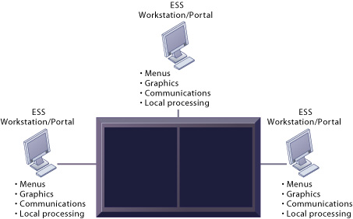
Model ESS
FIGURE 2-8 Model of a typical executive support system
This system pools data from diverse internal and external sources and makes them available to executives in an easy-to-use form.

Slide 56
Exchange of data between the four systems
The various types of systems in the organization exchange data with one another.
TPS are a major source of data for other systems, especially MIS and DSS.
ESS is primarily a recipient of data from lower-level systems.
However, fully integrating all of an organization’s many systems can be very costly. [Figure 2-9]

Slide 57
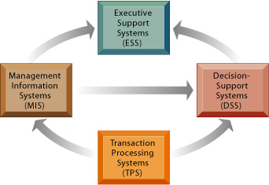
Inter-relationship
FIGURE 2-9 Interrelationships among systems
The various types of systems in the organization have interdependencies.
TPS are major producers of information that is required by the other systems, which, in turn, produce information for other systems.
These different types of systems have been loosely coupled in most organizations.

Slide 58
Systems from a Functional Perspective
At each level of the organization there are information systems supporting the major functional areas of the business.
Sales and marketing information systems help the firm identify customers for the firm’s products or services, develop products and services to meet their needs, promote these products and services, sell the products and services, and provide ongoing customer support.

Slide 59
Other Systems
Manufacturing and production information systems deal with the planning, development, and production of products and services, and controlling the flow of production.
Finance and accounting information systems keep track of the firm’s financial assets and fund flows.
Human resources information systems maintain employee records, track employee skills, job performance and training, and support planning for employee compensation and career development. [Figure 2-10, Figure 2-11]

Slide 60
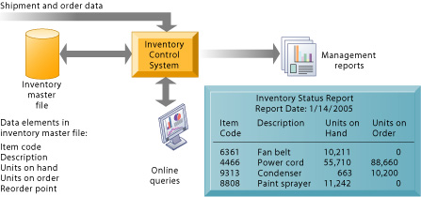
Inventory Systems
FIGURE 2-10 Overview of an inventory system
This system provides information about the number of items available in inventory to support manufacturing and production activities.

Slide 61
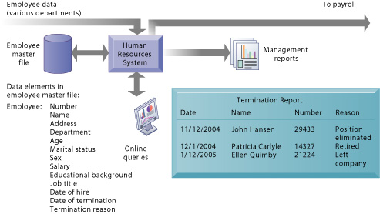
Employee Record System
FIGURE 2-11 An employee record keeping system
This system maintains data on the firm’s employees to support the human resources function.

Slide 62
Integrating Functions and Business Processes: Introduction to Enterprise Applications
Many firms are using information technology to build systems to further integrate key internal business processes and to link the firm's business processes to those customers, suppliers, and other companies in its industry.
Some business processes support the major functional areas of the firm while others are cross-functional, transcending boundaries between sales, marketing, manufacturing, and research and development. [Figure 2-12]

Slide 63
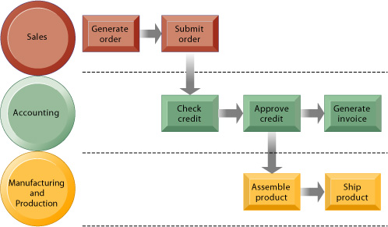
Order Processing
FIGURE 2-12 The order fulfillment process
Generating and fulfilling an order is a multistep process involving activities performed by the sales, manufacturing and production, and accounting functions.

Slide 64
Enterprise Application
Enterprise applications, consisting of enterprise systems and systems for supply chain management, customer relationship management, and knowledge management, are increasingly used for this purpose.

Slide 65
Business Process & Enterprise Applications
Deployment of enterprise applications requires firms to think more strategically about their business processes.
Business processes are the unique ways in which organizations coordinate and organize work activities, information, and knowledge to produce a valuable product or service.

Slide 66
Business Process & Enterprise Applications (Contd)
Organizations have business processes supporting each of the major business functions and business processes that span multiple functions.
Organizational efficiency can be increased by automating parts of these processes or by using information technology to redesign and streamline the processes. [Figure 2-13]

Slide 67
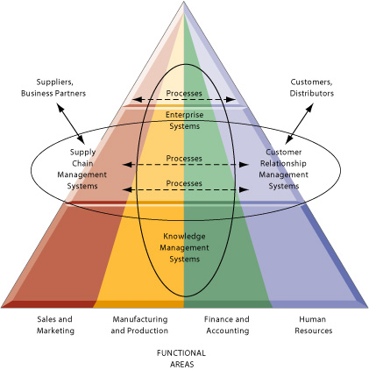
Enterprise Application Architecture
FIGURE 2-13 Enterprise application architecture
Enterprise applications automate processes that span multiple business functions and organizational levels and may extend outside the organization.

Slide 68
ERP
Enterprise systems, or enterprise resource planning (ERP) systems model and automate many business processes, such as filling an order or scheduling a shipment, with the goal of integrating information across the entire company and eliminating complex, expensive links between computer systems in different areas of the business.

Slide 69
ERP (Contd)
Information that was previously fragmented in different systems can seamlessly flow throughout the organization so that it can be shared by business processes in manufacturing, accounting, human resources, and other areas of the firm.
Discrete business processes from sales, production, finance, and logistics can be integrated into company-wide business processes that flow across organizational levels and functions. [Figure 2-14]

Slide 70
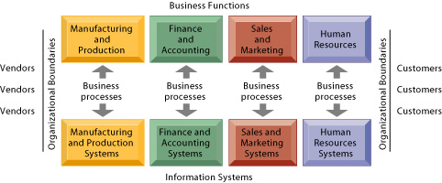
Traditional View
FIGURE 2-14 Traditional view of systems
In most organizations today, separate systems built over a long period of time support discrete business processes and discrete segments of the business value chain.
The organization’s systems rarely include vendors and customers.

Slide 71
Enterprise System & Data
The enterprise system collects data from various key business processes and stores the data in a single comprehensive data repository where they can be used by other parts of the business.
Managers emerge with more precise and timely information for coordinating the daily operations of the business and a firm-wide view of business processes and information flows. [Figure 2-15].

Slide 72
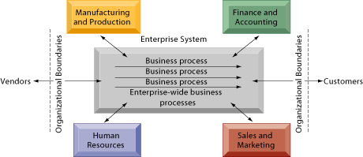
Enterprise System
FIGURE 2-15 Enterprise systems
Enterprise systems integrate the key business processes of an entire firm into a single software system that enables information to flow seamlessly throughout the organization.
These systems focus primarily on internal processes but may include transactions with customers and vendors.

Slide 73
Supply Chain Management
Supply chain management focuses on coordinating all of the activities and information flows involved in buying, making, and moving a product until it reaches the customer.
Supply chain management systems are a type of interorganizational system, crossing organizational boundaries, that provide information to help firms and suppliers control, and coordinate procurement, production, inventory management, and delivery of products and services to customers.

Slide 74
Supply Chain Management (contd)
Firms that skillfully manage their supply chains get the right amount of products from their source to point of consumption with the least amount of time and the lowest cost. [Figure 2-16]

Slide 75
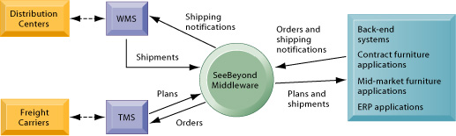
Supply Chain Management
FIGURE 2-16 Haworth’s supply chain management systems
Customer orders, shipping notifications, optimized shipping plans, and other supply chain information flow among Haworth’s Warehouse Management System (WMS), Transportation Management System (TMS), and its back-end enterprise systems and other corporate applications.

Slide 76
CRM
Customer relationship management (CRM) systems focus on coordinating the business processes surrounding a firm’s interactions with its customers in sales, marketing, and service, to optimize revenue, customer satisfaction, and customer retention.
They consolidate customer data from multiple sources and communication channels to help firms identify profitable customers, acquire new customers, improve service and support, and target products and services more precisely to customer preferences. [Figure 2-17]

Slide 77
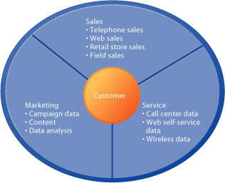
CRM
FIGURE 2-17 Customer relationship management (CRM)
Customer relationship management systems examine customers from a multifaceted perspective.
These systems use a net of integrated applications to address all aspects of the customer relationship, including customer service, sales, and marketing.

Slide 78
KMS
Knowledge management systems support processes for discovering and codifying knowledge, sharing knowledge, and distributing knowledge, as well as processes for creating new knowledge and integrating it into the organization.

Slide 79
Management Opportunities, Challenges, and Solutions
Information systems can enable a business to reach higher levels of productivity, earnings, and support for virtually all levels and functions, and enhance decision making.
Challenges include integration of multiple existing systems, training employees and managers in using the system, and creating systems that are truly productive and not merely conveniences.

Slide 80
Management Opportunities, Challenges, and Solutions
Solutions to these challenges include developing a 360-degree view of the firm’s information requirements and inventory of existing systems, identifying and evaluating the amount and type of training needed, and developing an accounting system that allocates costs to the appropriate groups within the firm.

